Slide 1
Intro to Web Assembly
16th May, 2022
5.00-6.00pm
Subtitle or speaker name
Speaker: Kenji Phang

Slide 2
Before we begin
This workshop will be recorded and submitted to Microsoft Learn
MTC Exam Voucher Giveaway
There will be a lucky draw for one MTC Exam Voucher which can be used to take a Microsoft Azure Exam for free
Attending Certificates will be available after the workshop

Slide 3


About me
CS @ Uni of Manchester
Microsoft Learn Student Ambassador (Alpha)
Interests: Web Technologies
Notes:
I am by no means an expert in this field, I am just a developer who is simply interested in this topic and all of this comes from my own research. I got into web assembly by doing a project on it and I found it cool and quite underrated so I’ve made it my personal mission to share it

Slide 4
Microsoft Learn Student Ambassador Program
- A Program run by Microsoft to upskill students to create social and technical impact
Why you should join?
A lot of opportunities (mentoring, connections,
projects etc)
Upskill yourself with 12 technical leagues
Make social and technical impact

Slide 5
Intro to Web Assembly
Speaker: Kenji Phang

Slide 6

Agenda
Introduction to Web Assembly
What is Web Assembly
How it works
Why you should care
Simple Demo
.Net Blazor Demo

Slide 7
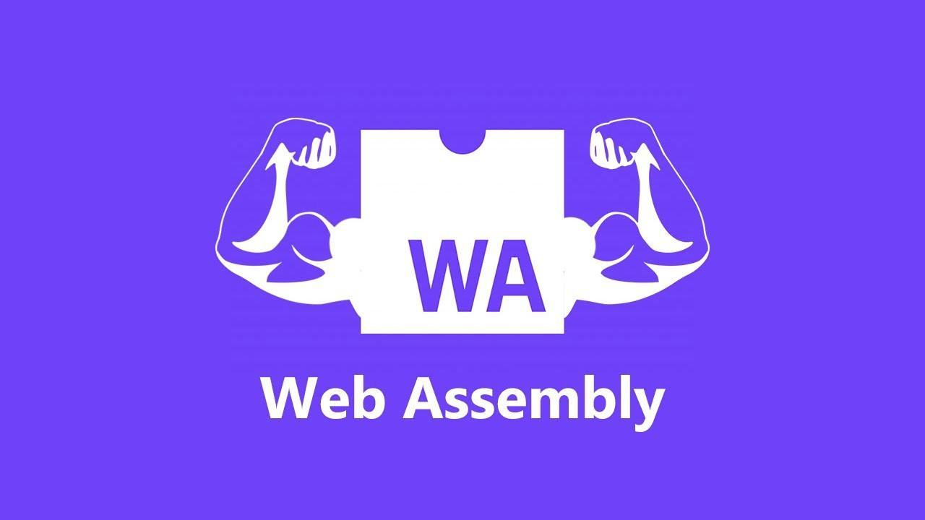
What is Web Assembly?
Notes:
Wasm is a new language and is also the latest major web standard, it was added in 2019, the last time this happened was with javascript and that was like 20 years ago so I hope that shows how important this addition is to the web
Yet a lot of people aren’t exactly sure what it is or what it does, from the questionnaire, I think only 1 person has used it before. I think it is severely underrated for what it brings
At first glance, it seems to have something to do with assembly code, maybe assembly for the web?

Slide 8
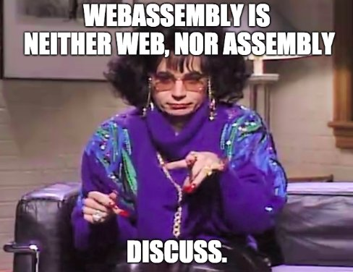
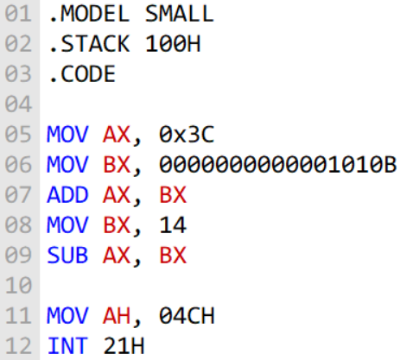
What is Web Assembly?
Notes:
Well it turns out that it is neither, Surprising isn’t it?
I guess it is kinda similar to assembly but let’s put this aside for now, I will come back to this later
To understand what web assembly is, we need take a step back and understand how it came to be

Slide 9
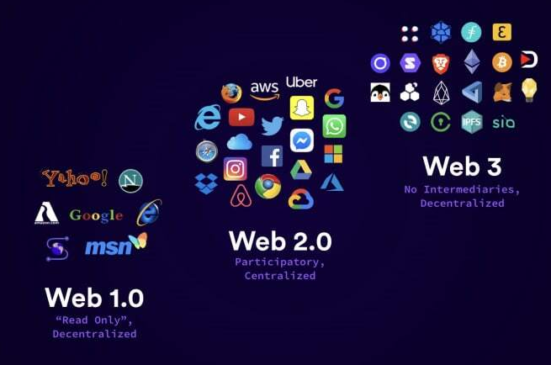
State of the web
Notes:
Let’s first look at the state of the web.
20 years ago, we were in a phase called web 1 where most pages are static and read-only, all they do is store and display information.
Then came web 2 which introduced the idea of being able to interact with our websites through web apps, which significantly changed how we used the Internet,
We could buy stuff online, do banking, get entertainment, then this became more complicated with cloud apps etc
This brought lots of opportunities and led to a tech boom, most top companies are still tech companies today
And now we have web3, which introduces decentralization.
I’m not going to steer this to be a web3 talk, but the main thing to notice here is between each shift in the stages, our applications are getting more and more computationally intensive and more complex
We want to be able to do more with our apps

Slide 10

Things we build nowadays
3D Games
VR and AR apps
Image recognition apps
Video Editing apps
Image Editing apps
Notes:
We have advanced to a point where we would like to build more computationally intensive web apps, apps like
3d games
vr and ar apps on your phone or headset for example
image recognition ai apps, for example a classifier app
video editing apps
and image editing apps like photoshop
But at one point, it was hard to do this on the web, people have tried but it was too slow in performance and using the software natively on your operating system was way better

Slide 11

Why do we want it on the web?
Flexible and convenient
Web is the medium for a lot of things
Easier to share and access
No need to download and setup
Notes:
Flexibility
The web is connected to a lot of things
Easier to share and access apps on the web, all you need is your browser
Don’t have to download and setup, maybe you have limited storage space and you can’t download too many apps
For example, if you want to remove a background on your image, you could download a background remover software, but then after you use it then it just stays there in your computer wasting storage space
instead, it would make more sense to just look for a web app that does that, upload your image and get the image back

Slide 12

But what was holding us back?
JavaScript is the only language for interactivity that can be processed by the browser
Everything compiles to JavaScript for frontend
Speed and Performance
JavaScript alone isn’t really suitable for applications
Notes:
But when we want to build these intensive applications in the browser, the one thing that was ironically holding us back is JavaScript.
For a refresher on what JavaScript is, it is a scripting language used for frontend applications
The main problem is that JavaScript is the only language for interactivity that can be processed by the browser, we can write frontends in other languages but it all compiles to JavaScript anyways before loaded onto your browser because it is the web standard
And JavaScript is not very good in speed and performance

Slide 13
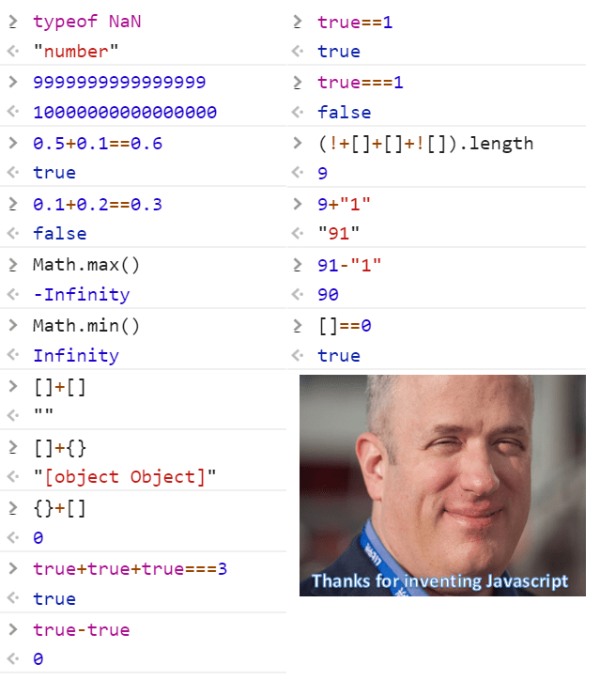
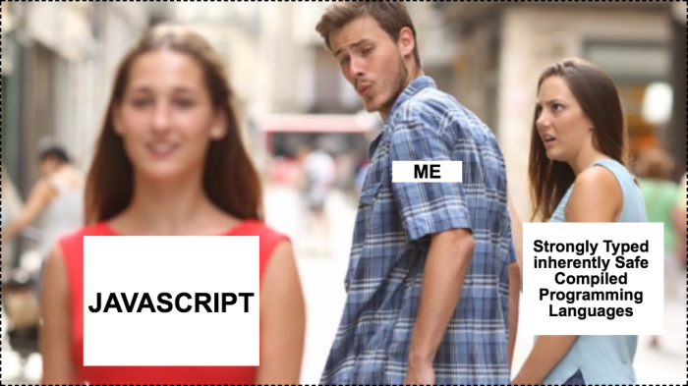
What is wrong with JavaScript?
Notes:
Lets take a look at some problems with JavaScript
First off it has a lot of weird rules that doesn’t really follow the standards set by other languages
I found this meme that accurately describes why JavaScript is not really good for building applications
Lets look at the first point, which is types

Slide 14

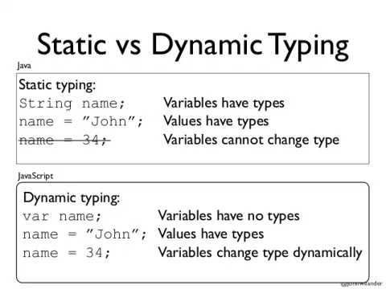
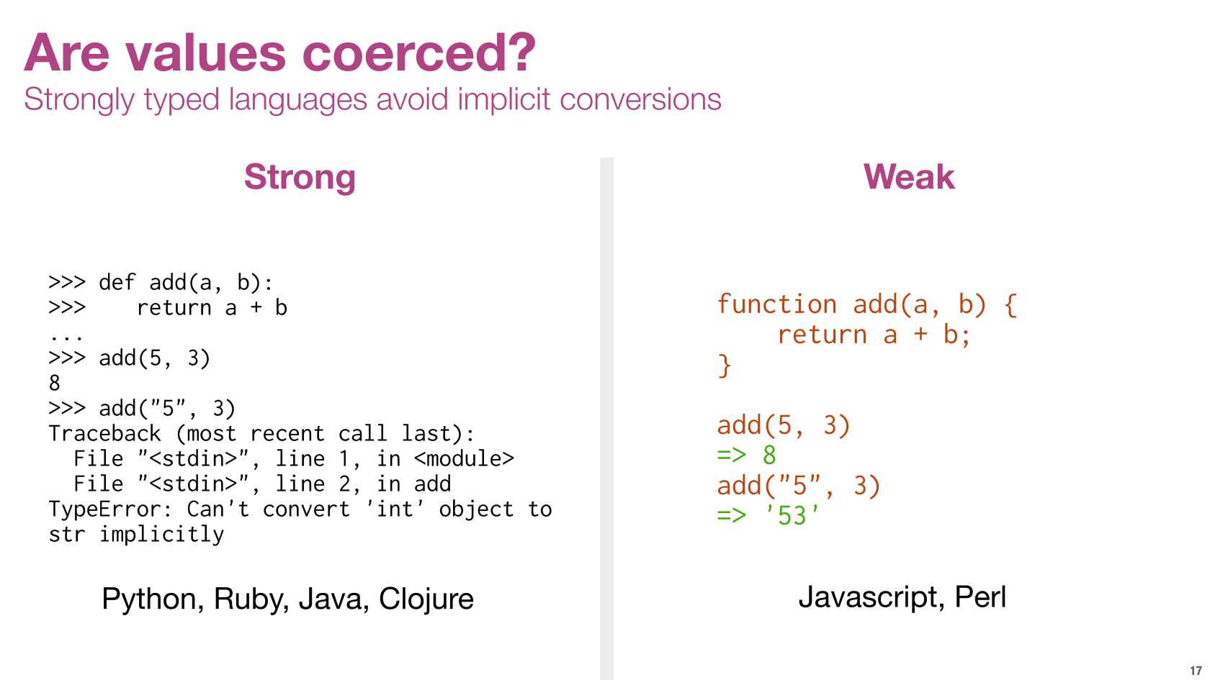
Types in JavaScript
Dynamic and Weak
Notes:
Well types are non existent in javascript
the more formal way to say this is JavaScript is dynamically and weakly typed
Here is an example of static vs dynamic
Here is an example of strong vs weak
Writing an application without types is hard, especially in large scale apps, you just pray that it works,
even in development, it is hard to develop the app because you cant access autocomplete features or syntax highlighting without knowing the types
Well there is a solution to this which is TypeScript but it only solves one problem

Slide 15
What is wrong with JavaScript?
Notes:
Next in the diagram is safety, I would argue that JavaScript is relatively safe because it is run through a VM in the browser, so let’s skip that.
What about JavaScript not being compiled?

Slide 16
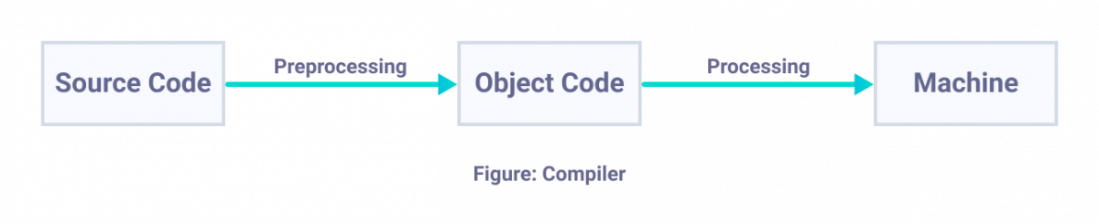
Compilers and Interpreters
Compiler
Transform all of the source code into another form
Intermediate representation/ machine code
Pros and Cons
Can optimize object code
Debug
Takes time to compile
Notes:
Here is some basic context about compilers and interpreters.
Compilers compile code into another form which can be machine code or some intermediate representation like bytecode.
Execution is fast because the output of the compiler can be executed directly
Now the main pro here is that it can optimize the code, rearrange lines to be faster
You can debug easily because compilers can check for correctness before compiling
But hard to debug runtime errors
The cons is that it takes a lot of time to compile

Slide 17
Compilers and Interpreters
Interpreter
Parses and executes source code line by line
Pros and Cons
Easy to debug
No compile time
Slow process at runtime
Notes:
On the other hand, interpreters parse code line by line and executes them
It is easy to debug because it fails on the line which has a bug
It has no compile time because you don’t have to transform or optimize it before execution
But you spend time parsing and processing the code at each line while running the code, there is a lot of extra overhead as well, for example, it has to spend time figuring out the types of the javascript code so it is much more slower
But in reality, I would argue that compiled languages are better because you sacrifice some time to compile, then the user enjoys the efficiency and the user experience is more important

Slide 18
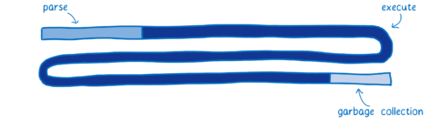
How JavaScript is run
JavaScript as an interpreted language
Run through a virtual machine in the browser
Notes:
So Javascript is an interpreted language
You can just take it as a fact that there is a virtual machine in your browser that can parse javascript
Here is a diagram of the JavaScript running in the browser as an interpreted language, it shows the combined time taken for each phase, not the process and steps.
Just a note, the diagrams here and in the next slides do not fully describe the process precisely but it is meant to give a high level idea.
At each line, you parse the code, then spend a long time executing. The garbage collection here is what makes JavaScript safe
Obviously, this was too long, so software engineers came up with a different approach

Slide 19
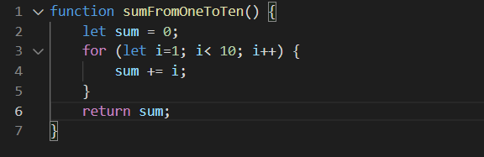
How JavaScript is run in the browser
V8 Engine and JIT (Just in time) compilation
Interpreter but finds repeated code and compiles them
Kind of like memoization
Tradeoff: code monitoring overhead
Notes:
In modern browsers, we have JIT compilers which sped up the process.
I’m just going to explain this briefly, you can think of it as an interpreter that finds code that is frequently repeated, compiles them and saves the compiled code in a table
so that when it parses the same line again, it just uses the stored compiled code.
Kind of like memoization for dynamic programming, you save the results somewhere so you don’t have to recompute them again.
Explain the example

Slide 20
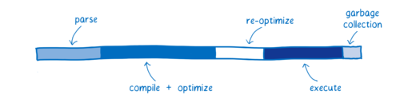
How JavaScript is run in the browser
V8 JavaScript Engine in the browser
JIT compilation
Notes:
As a result the diagram would be something more like this, the path is definitely a lot shorter and faster.
This is fast enough for most applications we write nowadays, but then again we are writing larger applications day by day, so we need something more efficient

Slide 21

Maybe server side rendering?
Throw the business logic to a server and use and API to interact
It is a viable solution, but
Offline services for PWAs
Might have slow connections for requests, too many users
Need to configure a server
Notes:
Maybe we can just use server side rendering, it is fast right? It is actually a viable solution but the bottleneck is the network latency and you would also need to configure a server.
But let’s look for another solution

Slide 22

What if we could compile code for the browser
Notes:
So think about this, what if we can just compile code for the browser, then we wouldn’t have to go through the jit process, this will save a lot of time and solve the performance issue
Furthermore, what if we make this compilation available from other languages as well

Slide 23
What if we just precompile programs?
Notes:
That is exactly what web assembly is about

Slide 24

New Frontend Stack
Notes:
it is a new web standard just like html css and js. Key thing to note is that this is a standard, which means that browsers should have support for this by default. This is quite an important event, because the last web standard was made in 1997 which is more than 20 years ago. Wasm was made a web standard in 2019, so it is still quite new but growing rapidly

Slide 25








What is Web Assembly? (Revisited)
Binary instruction format
Compilation target for multiple languages to run in the web!
Notes:
So what is web assembly? It is a binary instruction format and a compilation target for programming languages to allow them to run on the web,
It compiles into an intermediate representation, just like how Java converts source code into java bytecode or how C# has the common intermediate language
and the wasm can be run by the browser
You can now choose your favourite programming languages, turn them into wasm and execute them on your browser with close to native performance

Slide 26
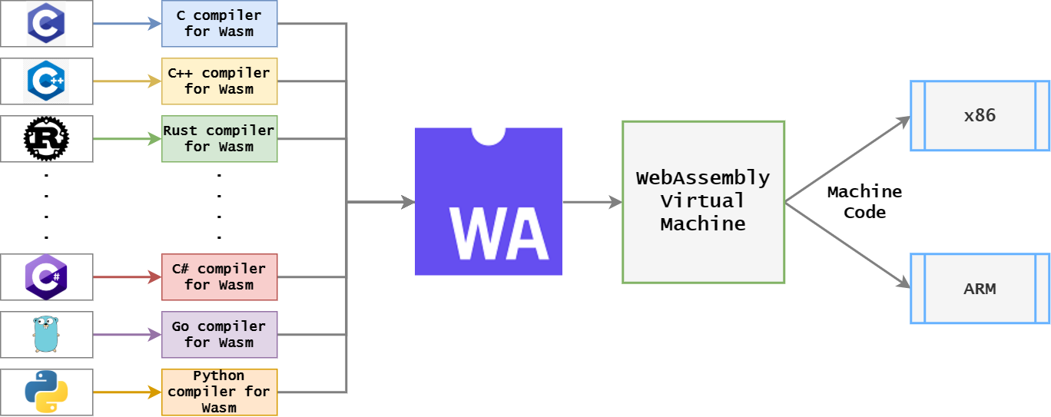
What is Web Assembly (revisited)?
Notes:
Here is another diagram to better explain the flow, All of the languages should now have a way to compile to wasm
the wasm can be run by the wasm virtual machine in your browser and it handles the output architecture for your computer
Essentially, just like Java

Slide 27
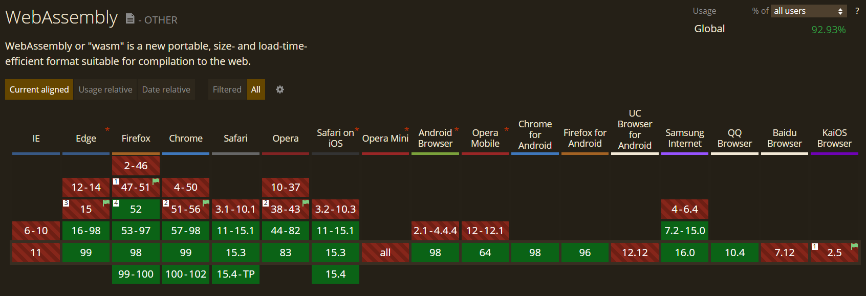
What is Web Assembly (revisited)?
Notes:
Since wasm is a web standard, most browsers should now have a virtual machine preinstalled to run the wasm code
Here is the diagram from caniuse,com. As you can see, most browsers now have support for web assembly

Slide 28
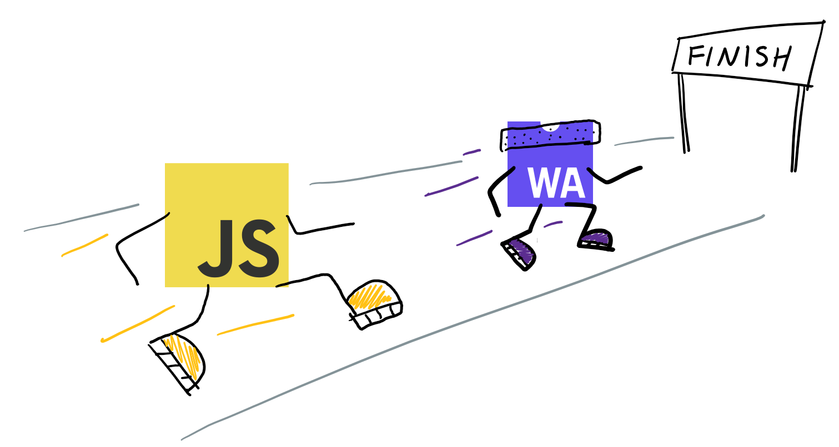
What are the benefits?
Fast and efficient
Compiled ahead of time
Compact binary format can be executed directly by the VM
Closer to machine code so loads faster
Notes:
What are the benefits of web assembly?
It is fast and efficient, You can run your code in near native performance.
Now, it is compiled ahead of time, your code would be optimized by the compiler and so all that is left is for it to be rendered by the vm, so it is fast.
Because it is also packed into a compact file, the wasm files generally have a smaller file size and leave a smaller footprint so they can be downloaded faster by the browser
It is safe and secure, because it is run in a sandbox environment in your browser

Slide 29
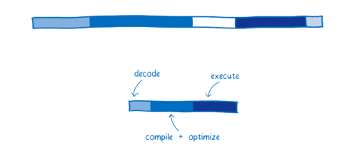
How does Web Assembly compare?
JIT
Wasm
Notes:
How does this compare to the previous diagram, the path is much shorter, because wasm is already a form of intermediate representation, it does not need to be parsed but just decoded,
the re optimization phase is not needed in wasm because the vm doesn’t need to make more assumptions for wasm compared to javascript and there is also no garbage collector because most wasm
now are written from low level languages like c++ and rust that handle memory manually
So it is significantly faster

Slide 30

What are the benefits?
Safe and secure
Run in a sandbox environment
Doesn’t have access to OS
You control how much access you want to give
+ many more features
Notes:
It is safe and secure, because it is run in a sandbox environment in your browser
Overall, when you run a wasm file, it wont be able to tamper with your

Slide 31
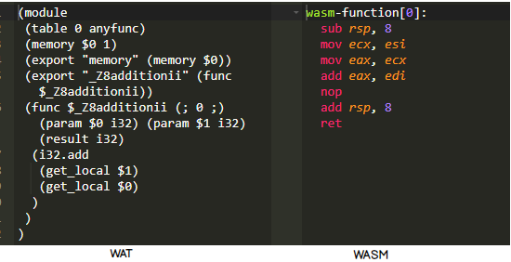
What are the benefits?
Easily Debuggable
Comprised of 2 formats
WebAssemblyText (.wat) -> Human readable
Binary format consumed (.wasm) by VM
Notes:
It is easily debuggable, one of the disadvantages of compilers mentioned previously is that it is hard to debug because it is hard to read assembly code
But now in wasm, there is a feature that allows you to easily convert the wasm code into another format called wat
ignore the assembly looking code on the right wasm is meant to be 1s and 0s but i cant find an image for it
Most browsers allow you to view wasm files by showing you the wat in your developer tools

Slide 32

Works alongside JavaScript
Doesn’t break the web
JavaScript advantages — it is dynamically typed, requires no compile step, and has a huge ecosystem that provides powerful frameworks, libraries, and other tools.
WebAssembly advantages — runs with near-native performance
Interact via API calls in both ways
**Move the more intensive part of the application to wasm
Notes:
You can use wasm on its own but It is build to work alongside javascript so you get the best of both worlds
For js, you get the ease of use and huge ecosystem
For wasm, you get near native performance
and they interact through api calls
So in an intensive large scale application, you can just move the expensive parts to wasm and interact with them from javascript

Slide 33
Small file size
Wasm files are compactly packed
can be optimized and compressed through compiler
smaller footprint
faster upload/download times on the web
https://www.youtube.com/watch?v=Qn_4F3foB3Q&t=12s
Notes:
You can use wasm on its own but It is build to work alongside javascript so you get the best of both worlds
For js, you get the ease of use and huge ecosystem
For wasm, you get near native performance
and they interact through api calls
So in an intensive large scale application, you can just move the expensive parts to wasm and interact with them from javascript

Slide 34
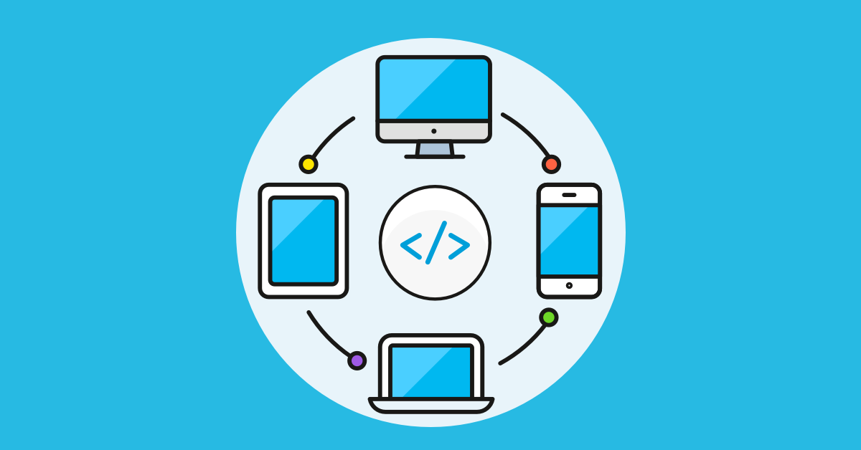
Portable
OS, platform agnostic (cross-platform)
Can run standalone on browser, or operating system
No need for containers
host runtimes
Notes:
You can use wasm on its own but It is build to work alongside javascript so you get the best of both worlds
For js, you get the ease of use and huge ecosystem
For wasm, you get near native performance
and they interact through api calls
So in an intensive large scale application, you can just move the expensive parts to wasm and interact with them from javascript

Slide 35

Work with others through wasm
Collaborate through wasm
Each coder can code in a different language, compile to wasm and everything works fine
Different languages can interact and share modules through wasm
Notes:
You can use wasm on its own but It is build to work alongside javascript so you get the best of both worlds
For js, you get the ease of use and huge ecosystem
For wasm, you get near native performance
and they interact through api calls
So in an intensive large scale application, you can just move the expensive parts to wasm and interact with them from javascript

Slide 36




How do I use web assembly in my app?
Porting a C/C++ application with Emscripten
Writing or generating web assembly directly at the assembly level
(writing WAT files)
Writing a Rust application and compile to wasm
Using AssemblyScript which is similar to TypeScript
Using .NET Blazor
Notes:
So now that we know what web assembly is, how do we write it? Well, remember that wasm is a binary format and an intermediate representation, we need to write our code somewhere else then compile it to wasm
there are multiple ways we can do this and many more ways, these are just the top few choices right now,
We can port a c/c++ app into wasm using emsceipten
We can write our code in wat directly then compile into wasm
We can write a rust application and compile it to wasm
Other than that, we can use assemblyscript, which is just like typescript but it can be compiled into wasm
And we can also let a framework do it for us, like .NET Blazor for example
So I am going to demo 2 of these, the first one is the rust application, because rust has a lot of tooling which makes it simple
And since this is a microsoft talk, we are going to be doing a demo on Blazor as well to showcase how the framework handles everything for us

Slide 37
How we can implement web assembly?
Simple Web Assembly Demo
Kenji Phang
Notes:
Shows hello world
Shows hello world with npm
Shows conways game of life
Talk about being unable to showcase image compression
One word of caution though is that, we don’t always need wasm, the difference between js and wasm are only noticeable when the applications are very intensive, like running a game

Slide 38
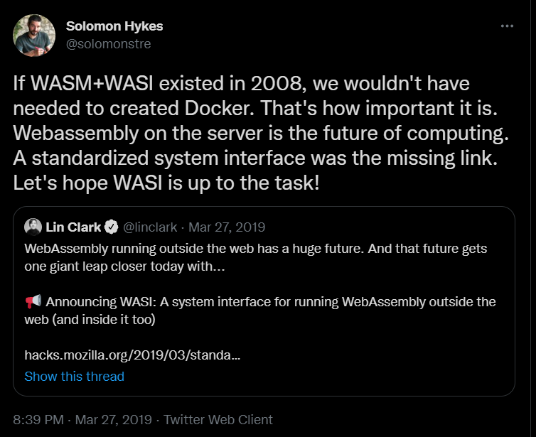
Why should you care?
Build more computing intensive websites
WASI
Future of containers
Serverless
Nanoservices
Blockchain (Smart Contract)
Fintech
Any distributed system (Cloud, Edge, IOT)
https://www.youtube.com/watch?v=lwAQiE7bU-8
Notes:
Why is this great? the idea of write once, run everywhere has been here for a while now, with java/c#, we want to just have to compile to one version for a vm and let it deal with the operating systems
instead of for doing it ourselves, we just need to prepare one version and it is guaranteed to run everywhere.
then, we also took this one step further with containers, by containerizing an environment along with the app, with like docker and kubernates which allowed for the ease of setup
and you know how we can take this one step further? by running containers in our browsers through wasm

Slide 39
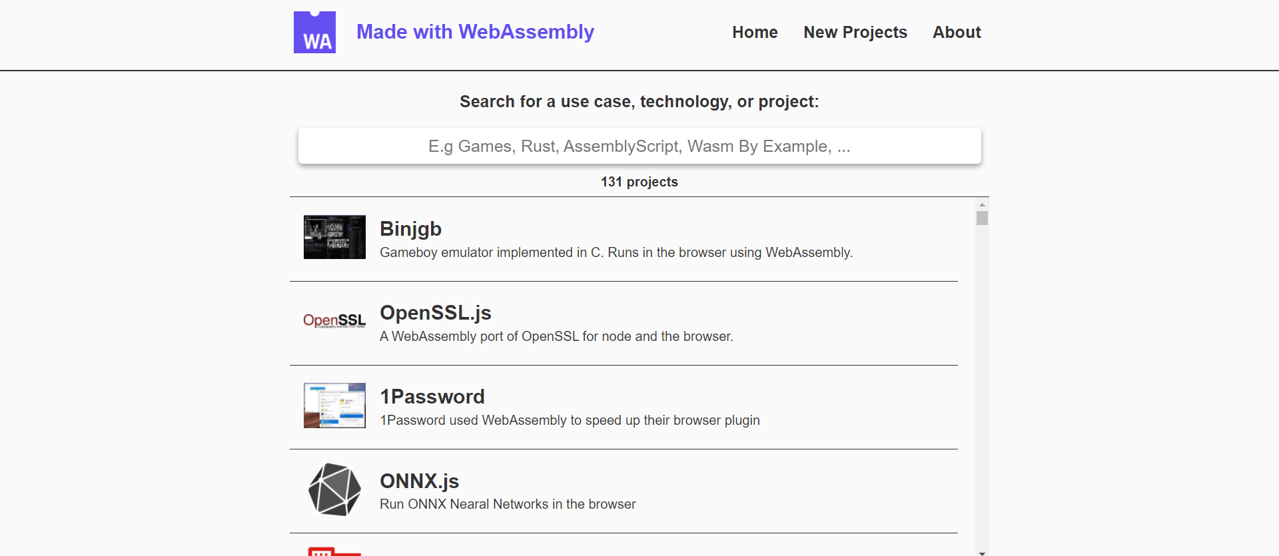
Who uses Web Assembly?
https://madewithwebassembly.com/
Notes:
So who actually uses web assembly? There is actually a website showing all projects made with web assembly so far. Let’s take a look at a few

Slide 40
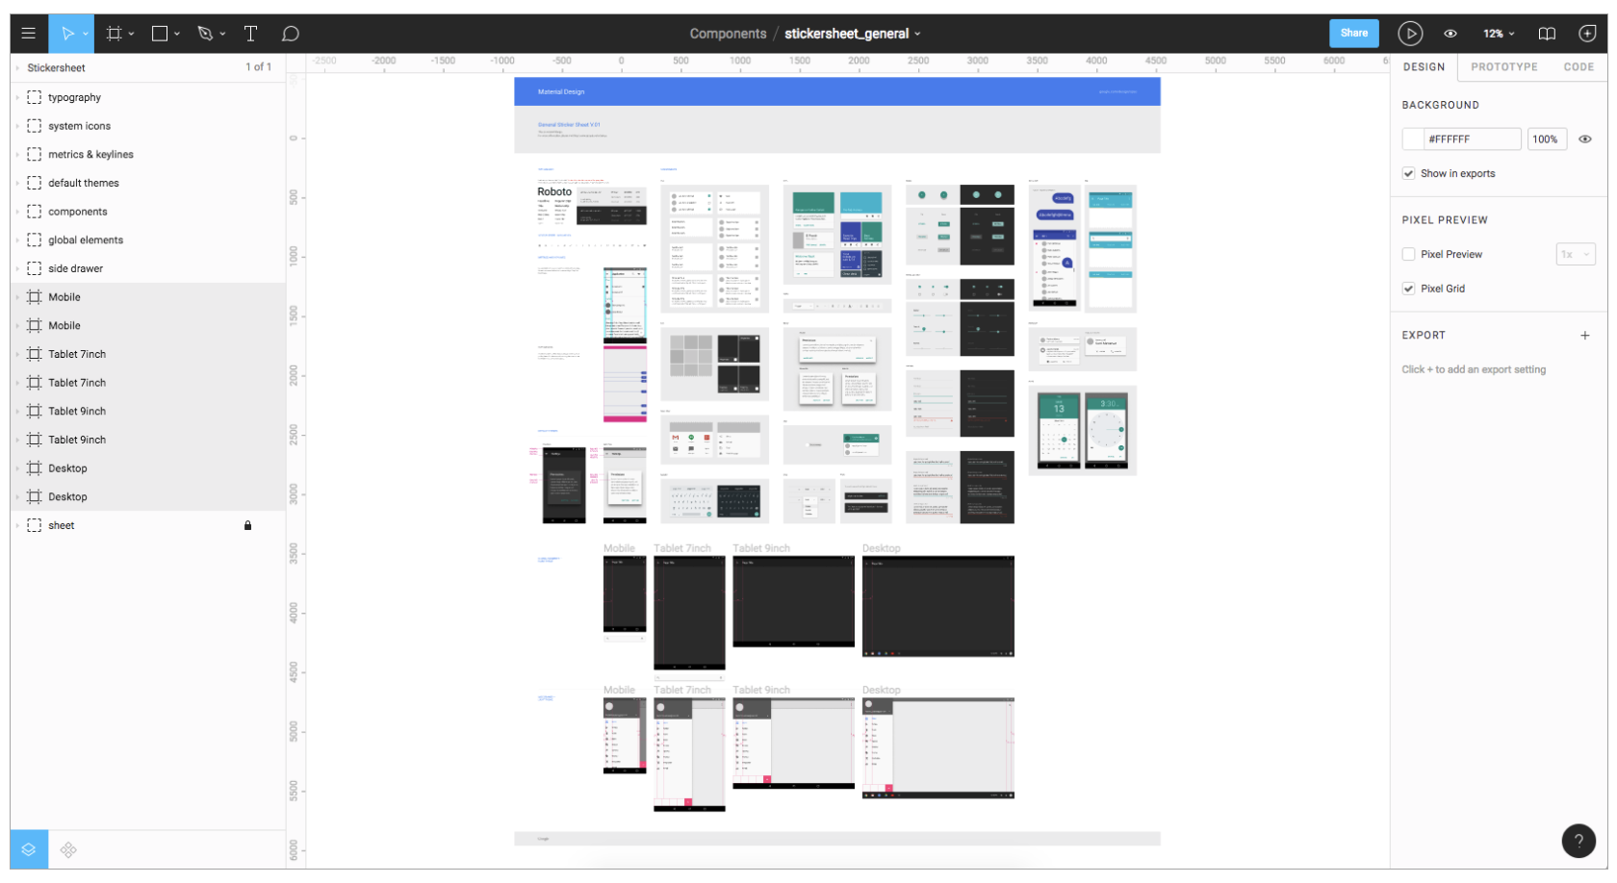

Who uses Web Assembly? Examples?
https://www.figma.com/blog/webassembly-cut-figmas-load-time-by-3x/
Notes:
Figma
Wireframing tool
Build mockups of applications directly from design
Multiple components on screen
Web Assembly cuts load time by 3x

Slide 41
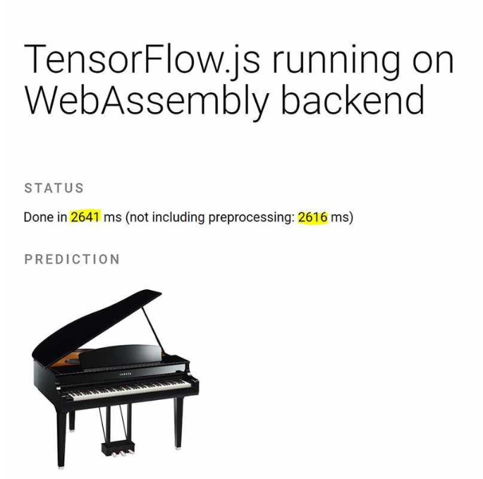
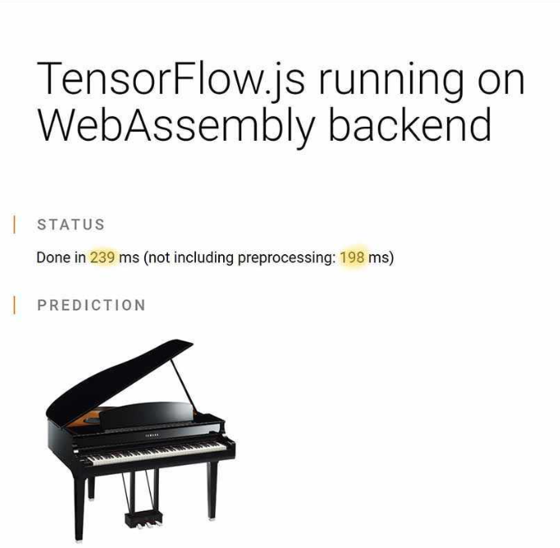

Who uses Web Assembly? Examples?
With plain JavaScript
With wasm
https://yashints.dev/blog/2019/12/17/tfjs-wasm

Slide 42
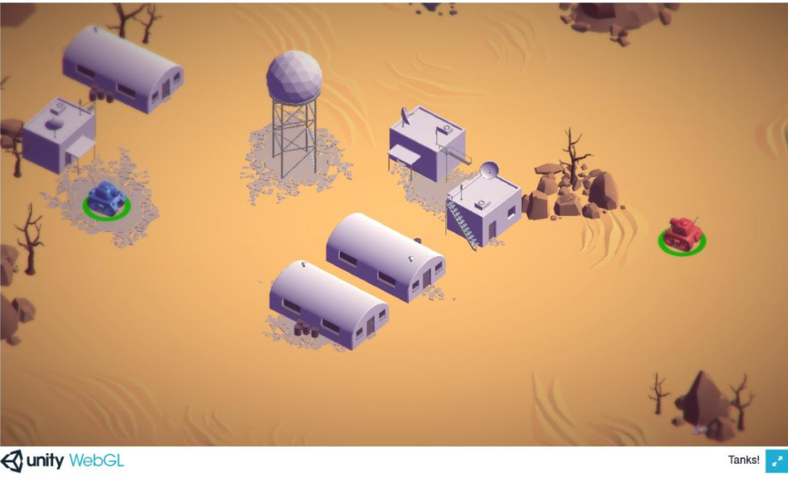

Who uses Web Assembly? Examples?
https://madewithwebassembly.com/showcase/unity
Notes:
This is a perfect example of the power that brings WASM to the table when used correctly. Game developers don’t really have to worry about writing for the web or even writing JavaScript, they’ll only need to worry about writing the code that will make the game run, and then the compilation process will take care of everything else.

Slide 43
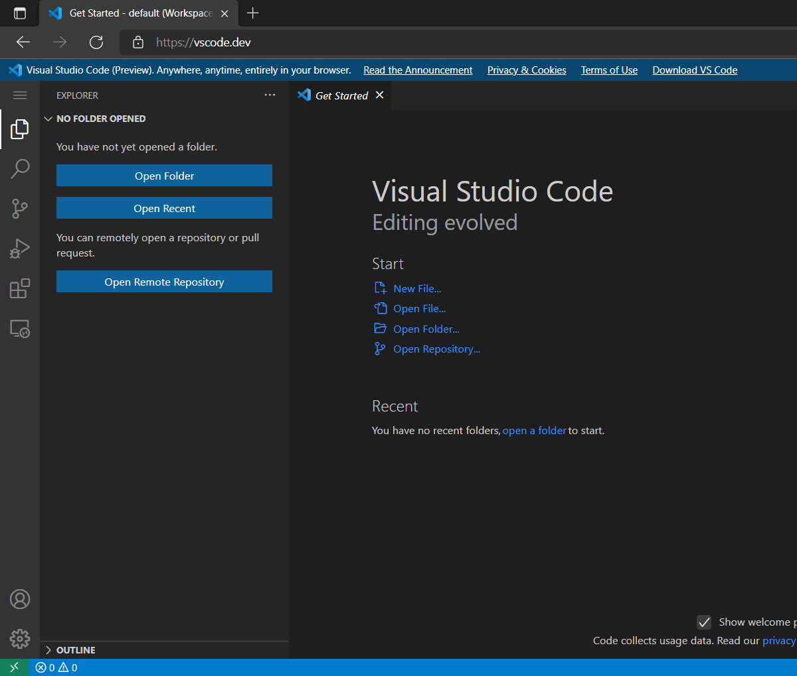
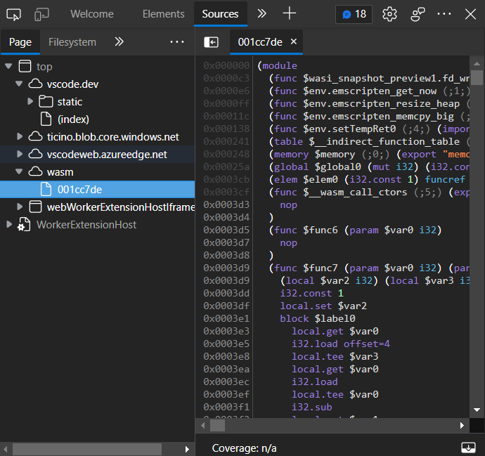
Who uses Web Assembly? Examples?
Get Started - default (Workspace) - Visual Studio Code (vscode.dev)

Slide 44
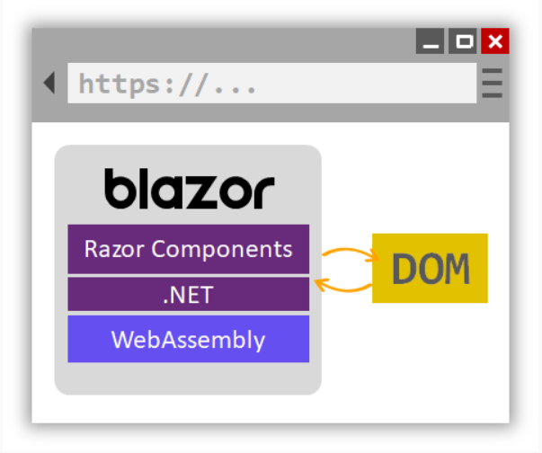
Who uses Web Assembly? Examples?
https://youtu.be/0RfUPr0KrSM

Slide 45
Blazor Web Assembly Demo
Kenji Phang

Slide 46
Key Takeaways
Web Assembly is a new web standard
Web Assembly helps us make computationally intensive web applications
Web Assembly has use cases in both client and server side
Web Assembly is everywhere
Web
Cloud
Operating System

Slide 47
Resources and Further Learning
Blazor, NET 6, and WebAssembly - Steven Sanderson - NDC Oslo 2021
https://www.youtube.com/watch?v=Rn8psTi8FBk&t=259s
Why WebAssembly is important | Use cases
https://www.youtube.com/watch?v=Rn8psTi8FBk&t=259s
https://www.youtube.com/watch?v=lwAQiE7bU-8
Publish a Blazor WebAssembly app and .NET API with Azure Static Web Apps
https://docs.microsoft.com/en-us/learn/modules/publish-app-service-static-web-app-api-dotnet/

Slide 48
Sources
Web Assembly Docs by Mozilla https://developer.mozilla.org/en-US/docs/WebAssembly
A crash course in assembly by Lin Clark https://hacks.mozilla.org/2017/02/a-crash-course-in-assembly/
Rust, WebAssembly, and the future of Serverless by Steve Klabnik https://www.youtube.com/watch?v=CMB6AlE1QuI
An introduction to web assembly by Coding Tech https://www.youtube.com/watch?v=3sU557ZKjUs
Whats wrong with web assembly? https://blog.bitsrc.io/whats-wrong-with-web-assembly-3b9abb671ec2
https://arghya.xyz/articles/webassembly-wasm-wasi/

Slide 49
Thanks for Attending
Contact: kenji.phang@studentambassadors.com
Github: @kenjipcx

